Slide 1


Cloud Download: Using Cloud Utilities to Achieve High-quality Content Distribution for Unpopular Videos
Yan Huang, Tencent Research, Shanghai, China
Zhenhua Li, Peking University, Beijing, China
Gang Liu, Tencent Research
Yafei Dai, Peking University

Slide 2
Outline
Motivation
State-of-the-art Techniques: CDN & P2P
Cloud Download
Production System Designs
Performance Evaluations
Ongoing Applications

Slide 3




Motivation (1)
Video content distribution has dominated the Internet traffic
- Cisco report: ~90% of consumer IP traffic will come from video content distribution, 2012
- Web video, P2P video
Therefore, High-quality video content distribution is of great significance
- 1. high data health
- 2. high data transfer rate
?

Slide 4

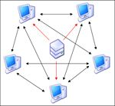
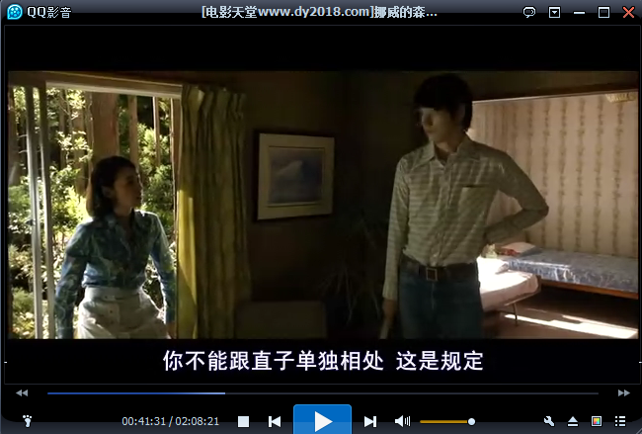
Motivation (2)
High data health
- Data health: number of available full copies of the shared file in a BitTorrent swarm
- Data health < 1.0 is unhealthy
- We use data health to represent data redundancy level of a video file
High data transfer rate
- Enables online video streaming
- Live & VoD

Slide 5
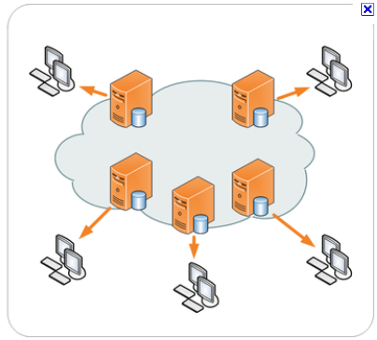
State-of-the-art Techniques (1): CDN
CDN (Content Distribution Network)
- Strategically deploying edge servers
- Cooperate to replicate or move data according to data popularity and server load
- User obtains copy from a nearby edge server
CDN: limited storage and bandwidth
- Not cost-effective for CDN to replicate unpopular videos to edge servers
- Charged facility only serving the content providers who have paid
Unpopular >> popular

Slide 6

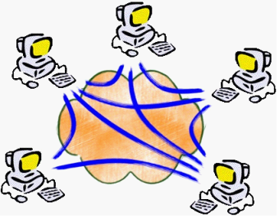
State-of-the-art Techniques (2): P2P
P2P (Peer-to-Peer)
- End users form P2P data swarms
- Data directly exchanged between peers
- Real strength shows for popular file sharing
Poor performance for unpopular videos
- Too few peers
→ low data health
→ low data transfer rate

Slide 7
CDN and P2P work well in distributing popular videos,
but neither of them is satisfactory for unpopular videos,
due to low data health, low data transfer rate, or both.
Worldwide deployment of cloud utilities provides us with a new opportunity to solve the above problem ……

Slide 8


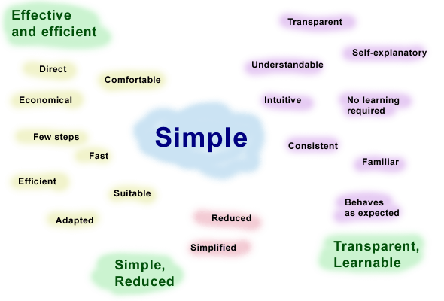
About our work
Today’s computer researchers face a dilemma
- Every year, we make efforts to construct complicated models and delicate algorithms which however have never been applied. —— One tragedy
- Every day, we are unsatisfied and even angry with current computer/Internet services. —— Another tragedy
Why our research seems to go in the reverse direction of benefiting computer users?
- We don’t know a pervasive answer or solution.
- But, our work may show you a simple, novel and solid work really works as to ~30M unique users!

Slide 9



Cloud Download
Use cloud utilities to guarantee the data health and enhance the data transfer rate
Cloud
High data rate !

Slide 10


Compared with CDN
Business model
- CDN: serves paid content providers
- Cloud download: charges users for better obtaining content
Video accommodation
- CDN: one movie - numerous copies at edge servers
- Cloud download: one movie - only two copies
(one for user access, the other for redundancy)
(unpopular video → two copies are enough)
- Cloud download can accommodate many more videos than CDN, with the same storage capacity
senders
receivers
Cloud

Slide 11



Cloud Download: User-side Energy Efficiency
Commonly download an unpopular video
- A common user keeps his computer (& NIC) powered-on for long hours
- Much Energy is wasted while waiting
Cloud download an unpopular video
- The user can just be “offline”
- When the video is ready, quickly retrieve it in short time
- User-side energy efficient !

Slide 12
Advantages of Cloud Download
For an unpopular video
1. guarantee data health
2. enhance data transfer rate
3. user-side energy efficiency

Slide 13

Cloud Download: View Startup Delay
For some videos
- Anxious user must wait for the cloud to download it
- Thus can’t view it at once
- The waiting time is view startup delay
This drawback is effectively alleviated
- By the implicit and secure data reuse among users
- The cloud only downloads a video when it is requested for the first time
- Subsequent requests directly satisfied
- Secure because oblivious to users
Cloud cache
Cache hit rate: 87% !

Slide 14
VideoCloud: Large-scale production system
System development
- Start since 06/2010
- 01/2011: 0.2M daily requests
- 09/2011: 0.72M daily requests
- Currently use 649 commodity servers
Major performances
- Average data transfer rate: 2.1 Mbps!
- 81% > 300 Kbps!
- User-side energy efficiency/saving: 89% !
Daily video requests
basic playback rate of online videos

Slide 15
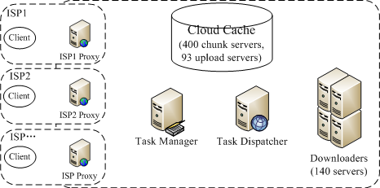

System Architecture
Data transfer
(high data rate)
Video request
Data store/cache
Data download
Check cache
If the client moves into another ISP when retrieving the video, the cloud can still recognize this and accelerate the data transfer.

Slide 16




Component Function
ISP Proxy: receive & restrict video requests in each ISP
Task Manager: check cache
Task Dispatcher: load balance
Downloaders: download data
Cloud Cache: store and upload data

Slide 17
Hardware Composition
Building Block | # of servers | Memory | Storage | Bandwidth
ISP Proxy | 6 | 8 GB | 250 GB | 1 Gbps (Intranet), 0.3 Gbps (Internet)
Task Manager | 4 | 8 GB | 250 GB | 1 Gbps (Intranet)
Task Dispatcher | 3 | 8 GB | 460 GB | 1 Gbps (Intranet)
Downloaders | 140 | 8 GB | 460 GB | 1 Gbps (Intranet), 0.325 Gbps (Internet)
Cloud Cache | 400 chunk servers 93 upload servers 3 index servers | 8 GB | 4 TB (chunk server), 250 GB (upload server) | 1 Gbps (Intranet), 0.3 Gbps (Internet)

Slide 18
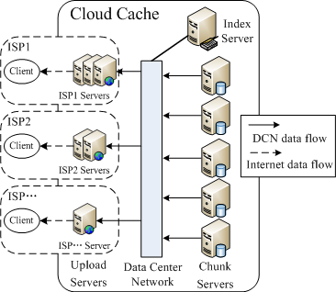
Data Transfer Acceleration
ISPs we support:
1. Telecom
2. Unicom
3. Mobile
4. CERNET
5. Tietong
6. GWBN
7. TBN
8. OCN
9. Teletron
10. Gehua
video

Slide 19
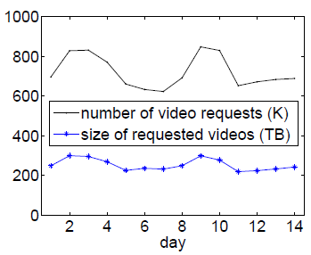
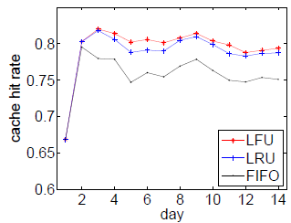
Cache Capacity Planning
& Replacement Strategy
Handle 1.0M daily requests
- Average video size: 390 MB
- Video cache duration: < 12 days
- Cloud cache hit rate: > 83%
- Thus, C = 390 MB * 1.0M *12 * (1-83%) = 796 TB < 800 TB ← Current Cache Capacity
Cache replacement strategies
- 14 days’ trace-driven simulations to see what if?
- FIFO vs. LRU vs. LFU
- FIFO worst, LFU best!

Slide 20
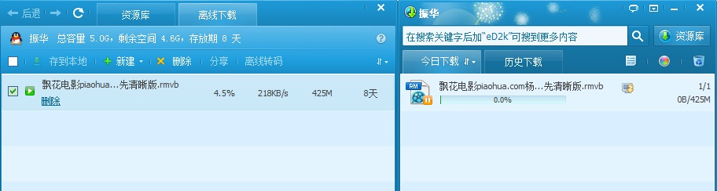
Performance Evaluation
Dataset
- complete running log of the VideoCloud system in 14 days: Sep. 9, 2011 -- Sep. 22, 2011
- 10.1M video requests, 1.38M unique videos
Metrics
- Data transfer rate
- View startup delay
- Energy efficiency
http://xf.qq.com
Cloud download
Common download

Slide 21
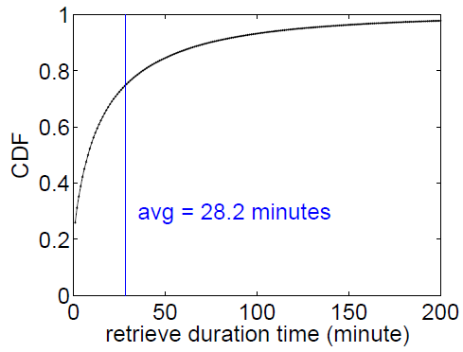
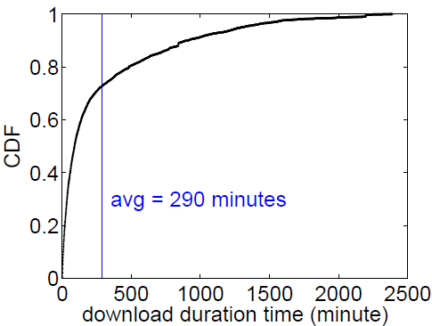
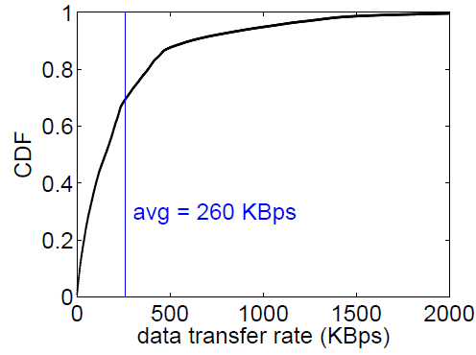
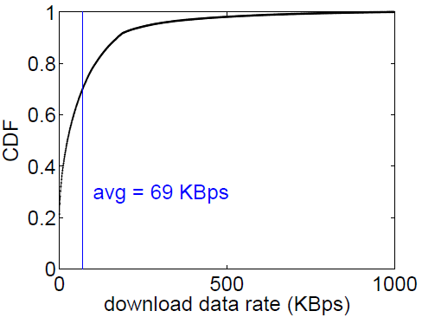
Cloud download vs. Common download
2.1 Mbps

Slide 22
Energy Efficiency (Energy Saving ratio)
User-side energy efficiency
- E₁: users’ energy consumption using common download
- E_{u}: users’ energy consumption using cloud download
- User-side energy efficiency = (E₁- E_{u})/E₁ = 89% !
Overall energy efficiency
- E_{c}: the cloud’s energy consumption
- E₂: the total energy consumption of the cloud and users, so E₂ = E_{c} + E_{u}
- Overall energy efficiency = (E₁- E₂)/E₁ = 85% !

Slide 23
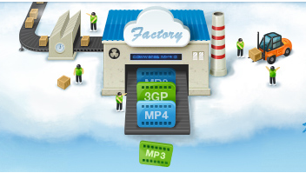


Ongoing Applications
Cloud Download can be applied to many Internet applications as a basic component
QQ iCare
http://icare.qq.com
Mobile reading while automatically pre-fetching potential contents via cloud download
Save traffic cost and reduce retrieve time for mobile users
iPhone & iPad implementation
Cloud Transcoding for mobile users
http://xf.qq.com
1. Mobile user submits a video link and the transcoding parameters to the cloud
2. The cloud downloads the video from Internet via cloud download
3. The cloud transcodes the downloaded video and transfers the transcoded video back to user

Slide 24

Q & A
This PPT is available at http://net.pku.edu.cn/~lzh/publications.html.

